Slide 1
“Nine People Charged in Largest Known Computer Hacking and Securities Fraud Scheme”
Aamir Shaikh
Jimmy Tran
Nine People Charged in Largest Known Computer Hacking and Securities Fraud Scheme. (2015, August 11). Retrieved August 30, 2017, from https://www.fbi.gov/contact-us/field-offices/newyork/news/press-releases/nine-people-charged-in-largest-known-computer-hacking-and-securities-fraud-scheme

Slide 2



The Scheme
US attorney Kelly Currie: “unholy alliance” of hackers and traders
Three business newswires hacked
  Marketwired L.P.
  PR Newswire Association LLC (PRN)
  Business Wire
Unreleased press releases stolen
  Up to 150,000 stolen
  At least 800 leaked

Slide 3

The Scheme
Inside traders given information ahead of time
Illegal trades worth more than $30 million over three years
Profits shared through foreign shell companies

Slide 4

Members
Comprised of hackers, security industry professionals, and inside traders
  Ivan Turchynov of Ukraine
  Oleksandr Ieremenko of Ukraine
  Pavel Dubovoyall of Ukraine
  Arkadiy Dubovoy of Alpharetta, Georgia
  Igor Dubovoy of Alpharetta, Georgia
  Vitaly Korchevsky of Glen Mills, Pennsylvania (also a former Securities and Exchange Commission member)
  Vladislav Khalupsky of Brooklyn, New York; and Odessa, Ukraine
  Leonid Momotok of Suwanee, Georgia
  Alexander Garkusha of Cummings and Alpharetta, Georgia

Slide 5
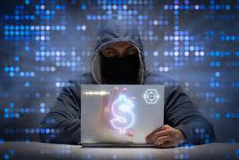
Crimes
Wire fraud and conspiracy
Securities fraud and conspiracy
Money laundering
Turchynov and Ieremenko only:
  Computer fraud and conspiracy
  Aggravated identity theft

Slide 6
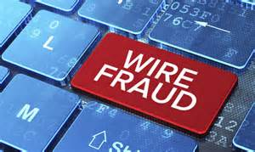
Wire Fraud
Wire fraud is an intentional act to defraud another individual or entity of his money or property.
In other words it’s a financial fraud involving the use of telecommunications or information technology.
Origin dates back to 1872 when it was added into the U.S legal system
is a federal crime punishable by up to 30 years in prison.
Committed using interstate wires, television or radio communications, or the Internet.

Slide 7
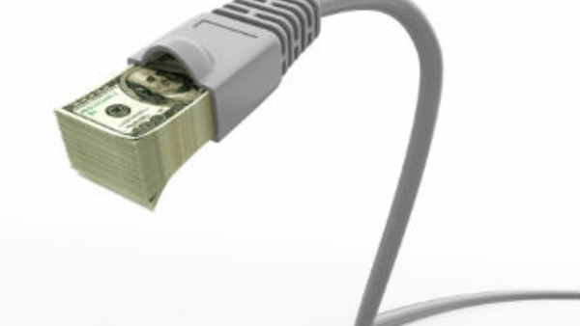
Wire Fraud
To successfully charge an individual with wire fraud, the crime must meet four specific elements:
The defendant voluntarily concocted, or participated in, a scheme to defraud a person or entity out of money, or something else of value
The defendant perpetrated the scheme with the intent to defraud the victim
The defendant used interstate wire communications to perpetrate the fraud
The defendant should have known that interstate wire communications would be used to complete the fraud

Slide 8
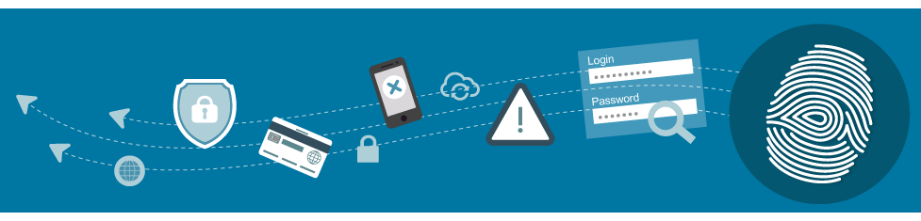
Security Fraud
A securities fraud is a type of serious white-collar crime in which a person or company, such as a stockbroker, brokerage firm, corporation, or investment bank misrepresents information that investors use to make decisions.
Securities Fraud can also be committed by independent individuals (such as by engaging in insider trading).
The types of misrepresentation involved in this crime include providing false information, withholding key information, offering bad advice, and offering or acting on inside information.

Slide 9

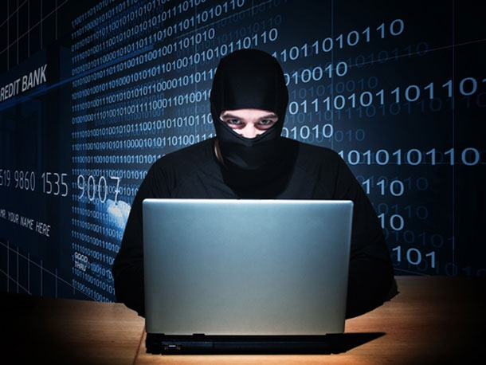
Computer Fraud
Fraud through the criminal use of a computer or the Internet can take many different forms.
“Hacking” is a common form, in which a perpetrator uses technological tools to remotely access a protected computer or system.
Another common form involves the interception of an electronic transmission unintended for the interceptor, such as passwords, credit card information, or other types of identity theft.
CFAA- Computer Fraud and Abuse Act (criminal statute)
Specifically, the CFAA prohibits computer espionage, computer trespassing in private or public computers, committing fraud with a computer, the distribution of malicious code, password trafficking, threatening to damage a protected computer.

Slide 10
Arrest
Some members monitored for years
2012: A member sent a chat message in Russian stating: “I’m hacking prnewswire.com.”
Ieremenko told Turchynov online that he had login information for 15 Business Wire employees
96 news releases sent with subject: “fresh stuff” in Russian
Five arrested at their homes
Other four remain in Ukraine

Slide 11
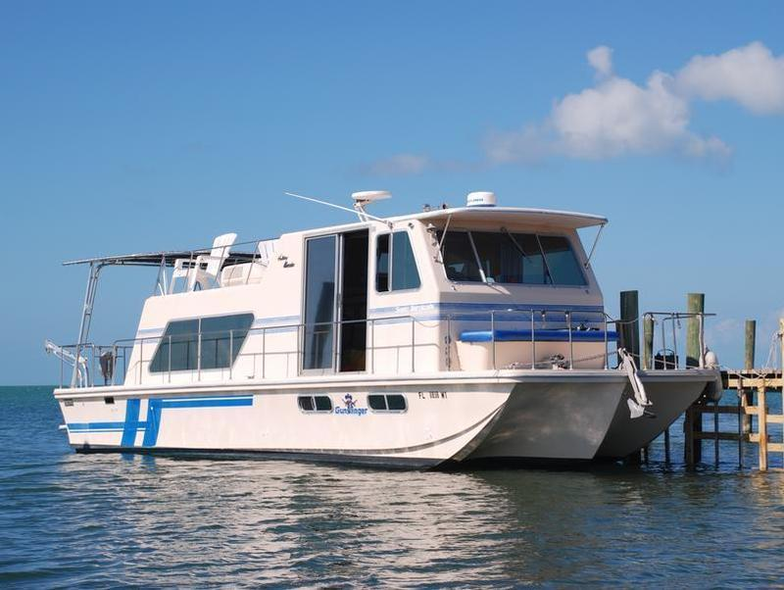
Recovery
Seventeen bank and brokerage account seized - $6.5 million
Twelve properties restrained - $5.5 million
  Shopping center in Pennsylvania
  Apartment building in Georgia
  A houseboat
International arrest warrants issued for remaining four of nine charged

Slide 12

Questions to think about...
*If you received insider information, where do you draw the ethical boundary between taking/not-taking action?
*Who has trial rights for the remaining four members, Ukraine or U.S?
*What are some things this group of hackers could have done to avoid being caught?

Slide 13
Sources
https://www.fbi.gov/contact-us/field-offices/newyork/news/press-releases/nine-people-charged-in-largest-known-computer-hacking-and-securities-fraud-scheme
https://www.nytimes.com/2015/08/12/business/dealbook/insider-trading-sec-hacking-case.html
https://legaldictionary.net/wire-fraud/
http://www.investopedia.com/terms/s/securities-fraud.asp
https://www.law.cornell.edu/wex/computer_and_internet_fraud

